Slide 1

T-test using Python
Statistics Activity
Dr. Rabia Musheer
Probability, Statistics And Reliability
MAT3003 - F11+F12+F13

Slide 2
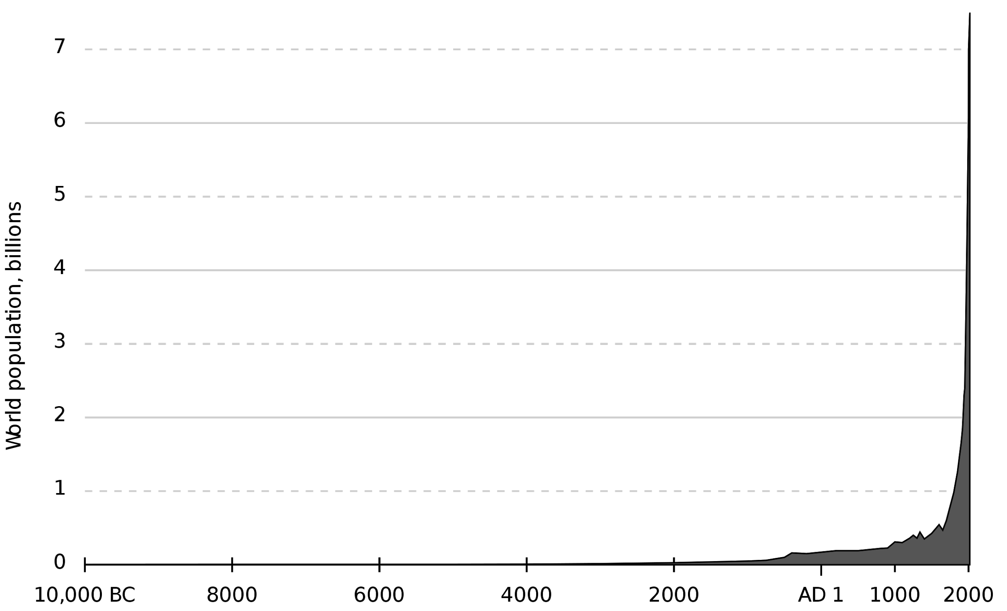
Team Members
Vardaan Vishnu 19BCE10063
Anirban 19BCY10091
Ali Asgar 19BCY10023
Aneesh Dogra 19BCY10169
Shivraj Pisal 19BCY10001
Praveen Kumar 19BCY10149

Slide 3
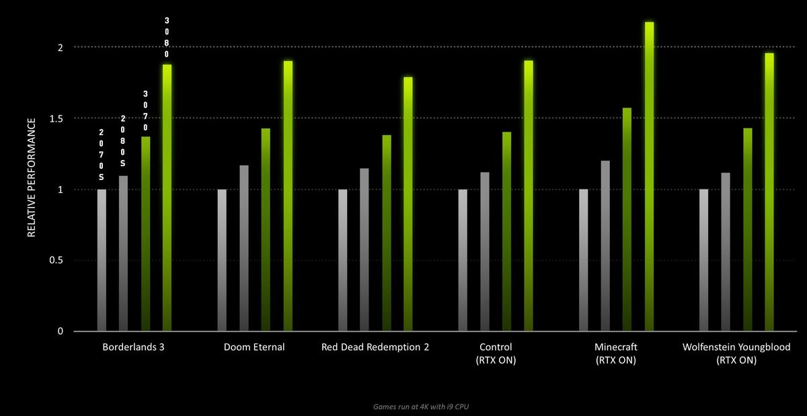
Problem Statement
RTX 20 Series vs RTX 30 Series
Standard Conditions:-
1. Application- Borderlands-3.
2. Processor- Intel i9-9900K(unlocked)
3. Ram- 4*8 Quad channel @3400mhz
4. Psu- 750 watt (platinum rated or above )
5. SSD- Nvme
Borderlands 3

Slide 4
What is T-test
The T-test is a statistical test used to determine whether a numeric data sample differs significantly from the population or whether two samples differ from one another.
It tells us if there is a significant difference between two sets of data
It lets us know if those differences could have happened by chance
It doesn't look at only mean but the spread of standard deviation to derive at a conclusion how significant two data sets are

Slide 5
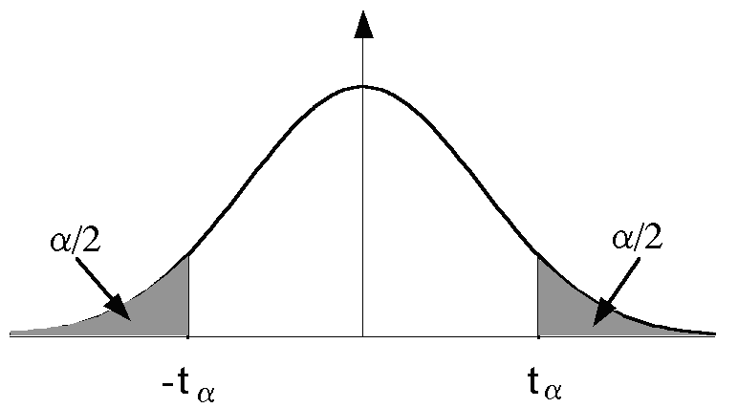
T-Distribution Tables
The t distribution table values are critical values of the t distribution. The column header are the t distribution probabilities (alpha). The row names are the degrees of freedom (df).
In the example below: with df = 10, for t=2.228, the probability is alpha=0.05

Slide 6
Statistical Hypothesis
Null Hypothesis : It assumes there is no statistically significant difference for the population being tested. For instance, if we wanted to test whether the average age of students in a local school differs from the national average, the null hypothesis would be that there is no difference between the average ages.
Alternative Hypothesis : It states that in fact there is significant difference for the population being tested. For instance, the alternative hypothesis would be that the average age of students in a local school does in fact differ from the national average.

Slide 7
Statistical Hypothesis
Significance level (α): The significance level is a probability threshold that determines when to reject the null hypothesis. Usually accepted significance level is 0.05. This means that there is 95% confidence that the conclusion of the test will be valid.

Slide 8
Types of T-tests
There are three main types of t-test:
A One sample t-test tests the mean of a single group against a known mean.
A one-tailed test is used to determine if the population is either lower than or higher than some hypothesized value.
For instance, if our H0: µ0 = µ and Ha: µ < µ0, such a test would be a one-sided test or more precisely, a left-tailed test.
Under such conditions, there is one rejection area only on the left tail of the distribution.

Slide 9
Types of T-tests
A Paired sample t-test compares means from the same group at different times (say, one year apart).
A two-tailed test rejects the null hypothesis in cases where the sample mean is significantly higher or lower than the assumed value of the mean of the population.
The two-tailed test is appropriate when we have H0: µ = µ0 and Ha: µ ≠ µ0 which may mean µ > µ0 or µ < µ0.
Therefore, in a two-tailed test, there are two rejection regions, one in either direction, left and right, towards each tail of the curve.

Slide 10
Types of T-tests
An Independent Samples t-test compares the means for two groups.
Subjects in each sample are also assumed to come from different populations, that is, subjects in “Sample A” are assumed to come from “Population A” and subjects in “Sample B” are assumed to come from “Population B”
The populations are assumed to differ only in the level of the independent variable.

Slide 11
T-test in Python
The T-test program in python gives two values:
T- Value
It is the ratio of difference between two groups and the difference within the groups.
A large t-value tells us that the groups are different.
A small t-value tells us that the groups are similar.
It tells us how much the sample mean deviates from the null hypothesis.

Slide 12
T-test in Python
P- Value
The p-value is the Probability that tells that result from sample data occurred by chance.
Low p-value indicates that data did not occur by chance.
For example, a p-value of 0.01 means there is only a 1% probability that the results from an experiment happened by chance.
Usually, it is accepted that if the p-value is lower than significance level α (equal to 0.05) , then we should reject the null hypothesis.

Slide 13
Outcome of T-Test
The outcome of the t-test produces the t-value.
This calculated t-value is then compared against a value obtained from a critical value table called the T-Distribution Table.
This comparison helps to question whether the difference between the groups represents a true difference in the study or if it is possibly a meaningless random difference.

Slide 14
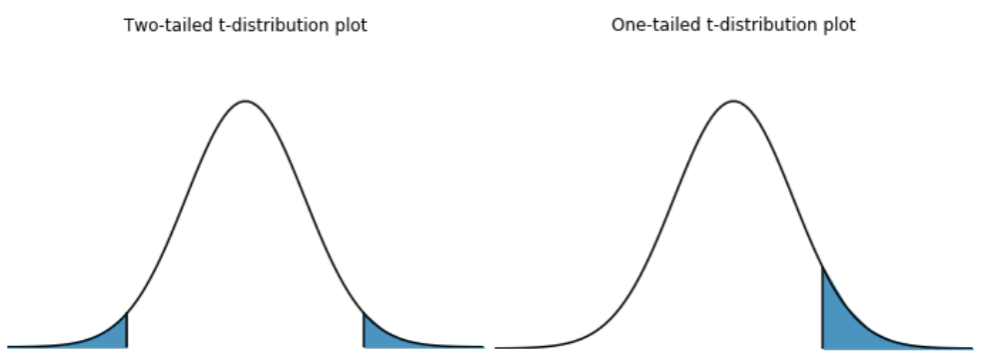
A Visual Analysis
The T-Distribution Table is available in one-tail and two-tails formats. The former is used for assessing cases which have a fixed value or range with a clear direction (positive or negative).

Slide 15
Degrees of Freedom
Degrees of freedom of an estimate is the number of independent pieces of information that went into calculating the estimate. It’s not quite the same as the number of items in the sample. In order to get the df for the estimate, you have to subtract 1 from the number of items. Let’s say you were finding the mean weight loss for a low-carb diet. You could use 4 people, giving 3 degrees of freedom (4 – 1 = 3), or you could use one hundred people with df = 99.
Mathematically represented as : n-1 (where n is the number of items in the set)

Slide 16
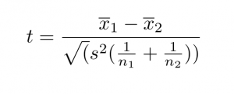
Mathematical Formula
The formula for computing the t-value and degrees of freedom for a paired t-test is:
​
Where:
x̄(1 and 2) is: The average values of each of the sample sets
s is: The Standard deviation of the two paired sets
n (1 and 2) is: The sample size (no of paired differences)
Degrees of freedom can be found out by doing (n-1)
These concepts are shown in the python code.

Slide 17

Thank You

